Slide 1
Lecture 5: Estimating Demand Functions with Travel Cost Models
Prof. Theising
Environmental Economics Econ 4075

Slide 2
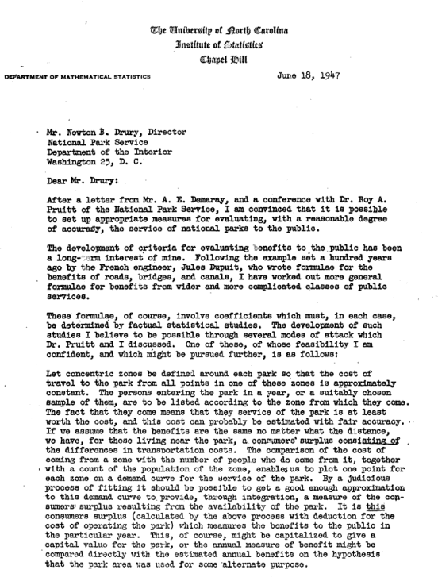
The Travel Cost Model
In June of 1947, the National Parks Service, headed by Arthur Demaray, reached out to a group of economists to ask about the feasibility of estimating the economic value of the national park system.
In response they received 10 letters. One of these letters was from Harold Hotelling.

Slide 4
Overview: Travel Cost Method
The travel cost approach typically uses data on recreational visitation to measure the revealed value of the recreational site and its amenities
Key idea: travel costs (time, $, effort) that people incur to use a recreational site effectively gives us variation in access prices
We can estimate WTP based on the amount of visits that the general population makes to sites of different prices
From the demand curve, we can value benefits or values of:
Opening/closure of a site/sites
Changes in environmental quality at a site/sites
Changes is cost of access for a site/sites

Slide 5
Theoretical model
Consider the case of a single consumer and a single recreational site.
Consumer’s problem (building from labor econ theory…) is to optimize their time allocation as a function of:
Total # of recreational trips: x, to a site of quality q, with per-trip time cost t
Total endowment of time: T
Time spent working: H
Non-recreation, non-work time: l
Per-time-unit wage: w
Monetary cost of reaching the site: c

Slide 6
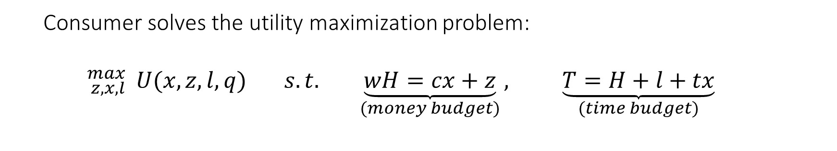
Theoretical model (cont.)
Consumer solves the utility maximization problem:
$${}_{z,x,l}^{max}{ U(x,z,l,q)} s.t. \underset{(money budget)}{\underbrace{wH=cx+z}}, \underset{(time budget)}{\underbrace{T=H+l+tx}}$$

Slide 7
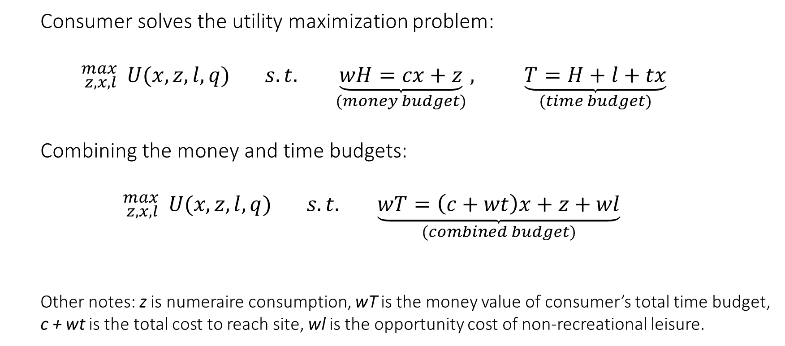
Theoretical model (cont.)
Consumer solves the utility maximization problem:
$${}_{z,x,l}^{max}{ U(x,z,l,q)} s.t. \underset{(money budget)}{\underbrace{wH=cx+z}}, \underset{(time budget)}{\underbrace{T=H+l+tx}}$$
Combining the money and time budgets:
$${}_{z,x,l}^{max}{ U(x,z,l,q)} s.t. \underset{(combined budget)}{\underbrace{wT=\left(c+wt\right)x+z+wl}}$$
Other notes: z is numeraire consumption, wT is the money value of consumer’s total time budget, c + wt is the total cost to reach site, wl is the opportunity cost of non-recreational leisure.

Slide 8
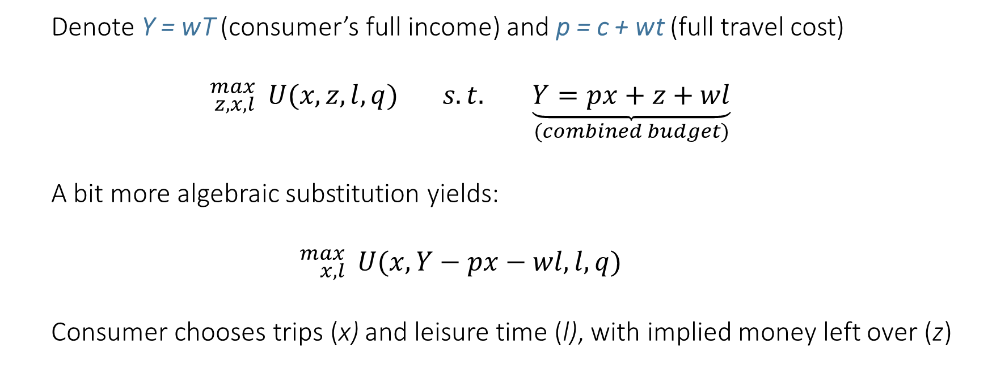
Theoretical model (cont.)
Denote Y = wT (consumer’s full income) and p = c + wt (full travel cost)
$${}_{z,x,l}^{max}{ U(x,z,l,q)} s.t. \underset{(combined budget)}{\underbrace{Y=px+z+wl}}$$
A bit more algebraic substitution yields:
$${}_{x,l}^{max}{ U(x,Y−px−wl,l,q)}$$
Consumer chooses trips (x) and leisure time (l), with implied money left over (z)

Slide 9
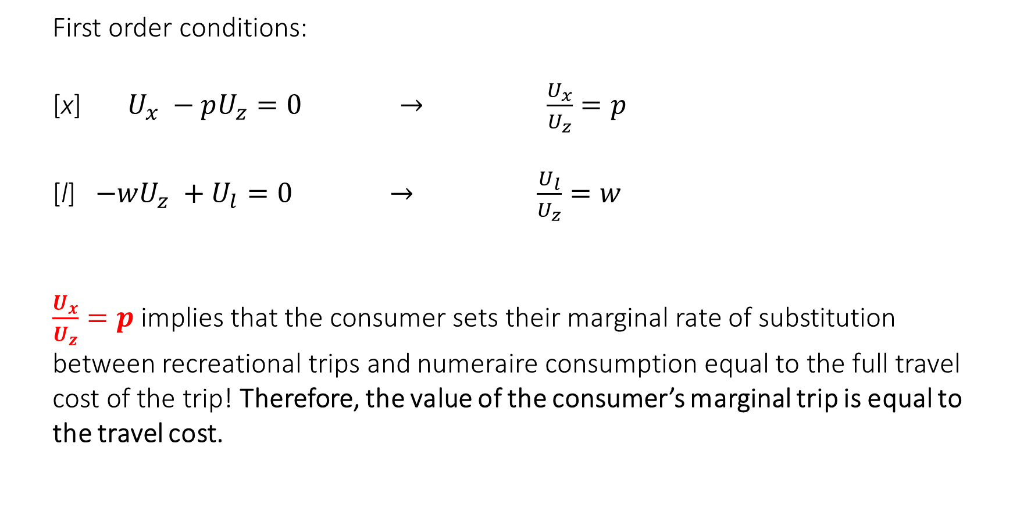
Theoretical model (cont.)
First order conditions:
[x] $U_{x} −pU_{z}=0 → \frac{U_{x}}{U_{z}}=p$
[l] $−wU_{z} +U_{l}=0 → \frac{U_{l}}{U_{z}}=w$
$\frac{U_{x}}{U_{z}}=p$ implies that the consumer sets their marginal rate of substitution between recreational trips and numeraire consumption equal to the full travel cost of the trip! Therefore, the value of the consumer’s marginal trip is equal to the travel cost.

Slide 10
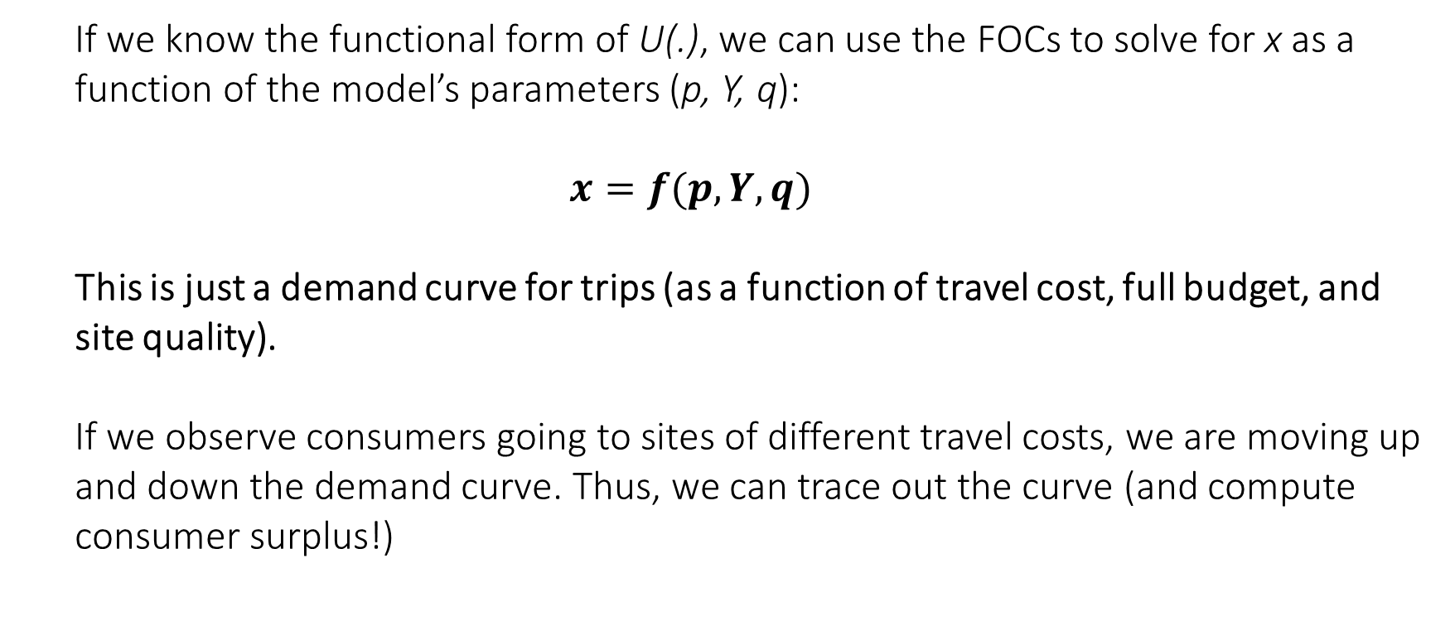
Theoretical model (cont.)
If we know the functional form of U(.), we can use the FOCs to solve for x as a function of the model’s parameters (p, Y, q):
$$x=f(p, Y, q)$$
This is just a demand curve for trips (as a function of travel cost, full budget, and site quality).
If we observe consumers going to sites of different travel costs, we are moving up and down the demand curve. Thus, we can trace out the curve (and compute consumer surplus!)

Slide 11
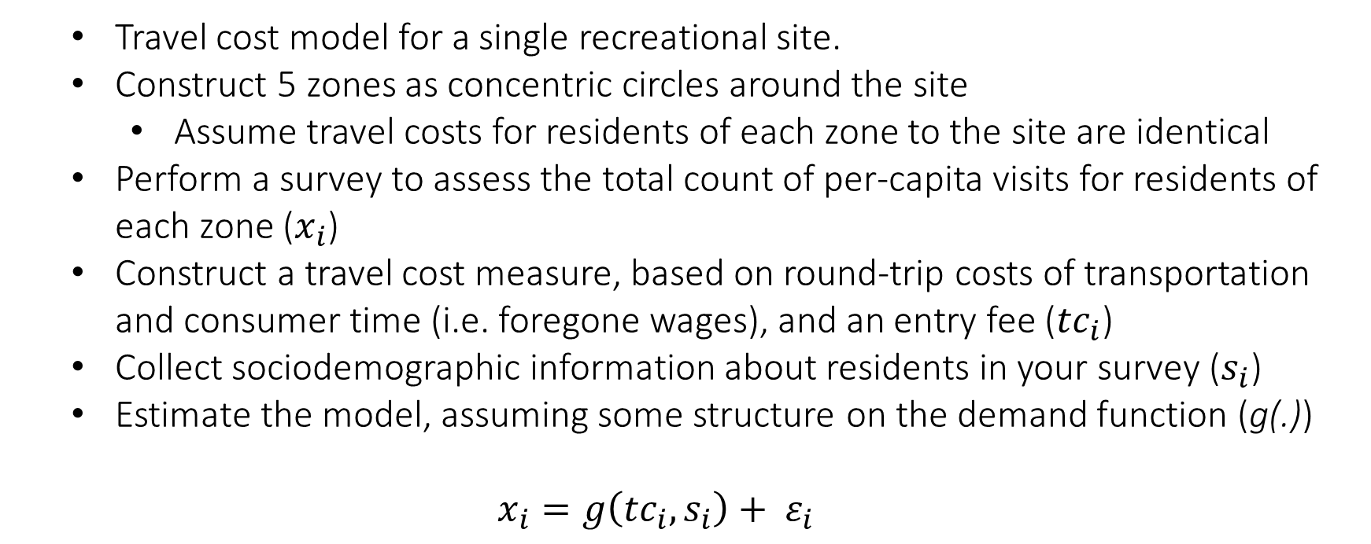
A stylized empirical version of the model
Travel cost model for a single recreational site.
Construct 5 zones as concentric circles around the site
Assume travel costs for residents of each zone to the site are identical
Perform a survey to assess the total count of per-capita visits for residents of each zone ($x_{i}$)
Construct a travel cost measure, based on round-trip costs of transportation and consumer time (i.e. foregone wages), and an entry fee (${tc}_{i}$)
Collect sociodemographic information about residents in your survey ($s_{i}$)
Estimate the model, assuming some structure on the demand function (g(.))
$$x_{i}=g\left({tc}_{i},s_{i}\right)+ ε_{i}$$

Slide 12
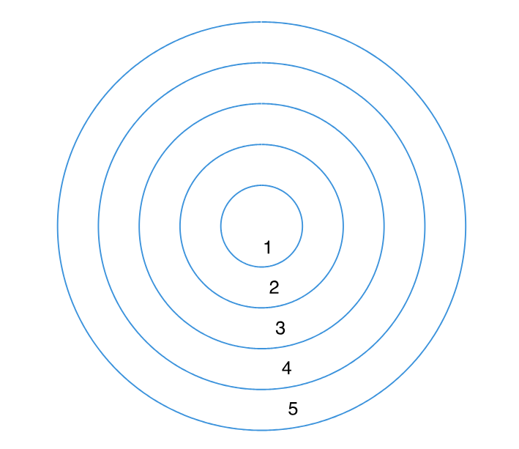
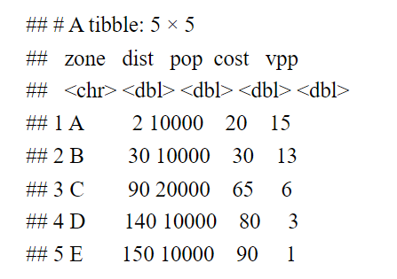
A stylized empirical version of the model
Suppose our survey returns data of the following nature:

Slide 13
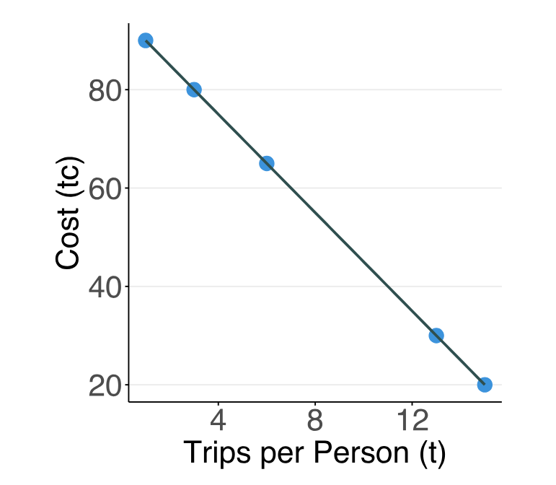
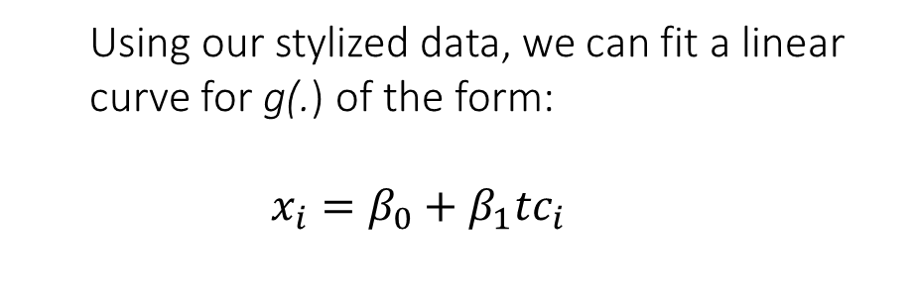
A stylized empirical version of the model
Using our stylized data, we can fit a linear curve for g(.) of the form:
$$x_{i}=β_{0}+β_{1}{tc}_{i}$$

Slide 14
A stylized empirical version of the model
What is the net benefit of this recreational site for residents of zone 3?
3

Slide 15
A stylized empirical version of the model
What is the net benefit of this recreational site for residents of zone 3?
For a given person from zone 3, per capita consumer surplus is given by integrating under the demand curve and netting out total visit costs.
In this stylized example, with linear demand, that’s given by the area of the orange triangle:
CS = 0.5 * 6 * (95-65) = $90
For 20,000 residents, the total net benefit is therefore $1.8 mil.
3

Slide 16
Multi-site Travel Cost Model
With a single site model, we can say something about the total value of the site. But what about the value of a site’s individual attributes?

Slide 17
Extending the Travel Cost Model
With a single site model, we can say something about the total value of the site. But what about the value of a site’s individual attributes?
In a single site model, there is no variation in attributes!
To value individual attributes and answer questions similar to the following, we need to estimate a multi-site model:
What is value of the site’s rock climbing walls?
What is benefit of a program to restock a park’s lakes with walleye?
What is recreational loss to deer hunters from chronic wasting disease?

Slide 18

Multi-site Travel Cost Model
$$V_{ijt} = λ{tc}_{ijt} + βX + φ +{ ε}_{ijt}$$

Slide 19







Multi-site Travel Cost Model
$$V_{ijt} = λ{tc}_{ijt} + βX + φ +{ ε}_{ijt}$$
$$=$$
$$+$$
$$+$$
$+ ?$

Slide 20





Multi-site Travel Cost Model
$$V_{ijt} = λ{tc}_{ijt} + βX + φ +{ ε}_{ijt}$$
$$=$$
$$+$$
$$+$$
$+ ?$

Slide 21



Multi-site Travel Cost Model
$$V_{ijt} = λ{tc}_{ijt} + βX + φ +{ ε}_{ijt}$$
$$=$$
$$+$$
$$+$$
$+ ?$

Slide 22

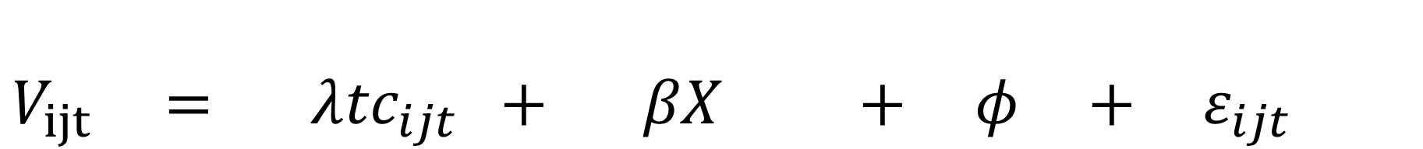
Multi-site Travel Cost Model
$$V_{ijt} = λ{tc}_{ijt} + βX + φ +{ ε}_{ijt}$$
$$=$$
$$+$$
$$+$$
$+ ?$

Slide 23


Multi-site Travel Cost Model
$$V_{ijt} = λ{tc}_{ijt} + βX + φ +{ ε}_{ijt}$$
$$=$$
$$+$$
$$+$$
$+ ?$

Slide 24








Multi-site Travel Cost Model
$$V_{ijt} = λ{tc}_{ijt} + βX + φ +{ ε}_{ijt}$$
$$=$$
$$+$$
$$+$$
$+ ?$
$$=$$
$$+$$
$$+$$
$+ ?$

Slide 25
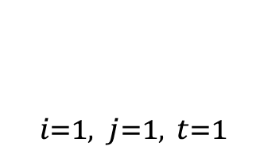
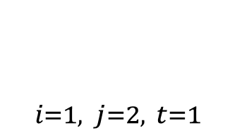
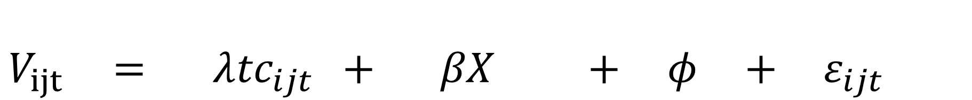
Multi-site Travel Cost Model
$$V_{ijt} = λ{tc}_{ijt} + βX + φ +{ ε}_{ijt}$$
$$=$$
$$+$$
$$+$$
$+ ?$
$X_{i=1, j=1, t=1}$
$$=$$
$$+$$
$$+$$
$+ ?$
$X_{i=1, j=2, t=1}$

Slide 26

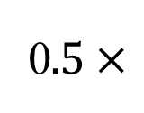
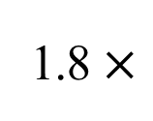
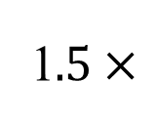


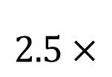
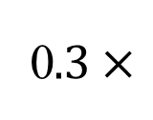

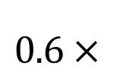


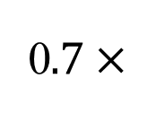
Multi-site Travel Cost Model
$$V_{ijt} = λ{tc}_{ijt} + βX + φ +{ ε}_{ijt}$$
1$.5×$
$$2.5×$$
$$35.1×$$
1.8 $×$
$$+$$
$$+$$
$$−0.05×$$
0$.5×$
0$.7×$
$$15.2×$$
$$0.6×$$
0$.3×$

Slide 27
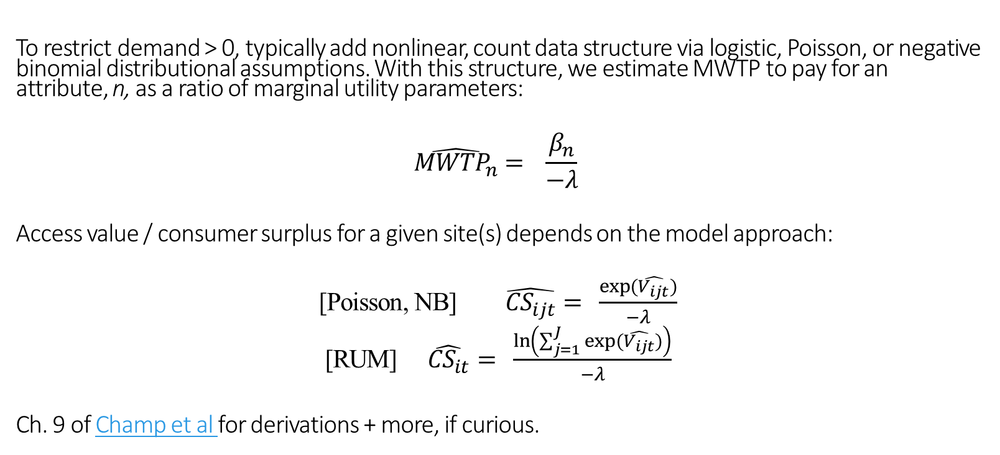
Multi-site Travel Cost Model
To restrict demand > 0, typically add nonlinear, count data structure via logistic, Poisson, or negative binomial distributional assumptions. With this structure, we estimate MWTP to pay for an attribute, n, as a ratio of marginal utility parameters:
$$\hat{{MWTP}_{n}}= \frac{β_{n}}{−λ}$$
Access value / consumer surplus for a given site(s) depends on the model approach:
[Poisson, NB] $\hat{{CS}_{ijt}}= \frac{exp(\hat{V_{ijt}})}{−λ}$
[RUM] $\hat{{CS}_{it}}= \frac{ln\left(\sum_{j=1}^{J}{exp(\hat{V_{ijt}})}\right)}{−λ}$
Ch. 9 of Champ et al for derivations + more, if curious.

Slide 28
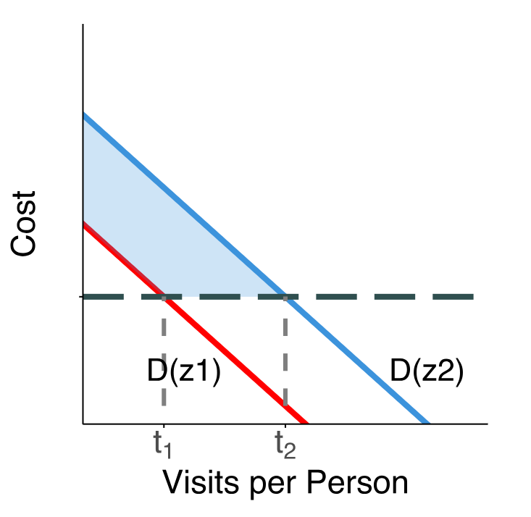
Multi-site Travel Cost Model
Final point: given the demand curve parameters we’ve estimated, we can explore how demand shifts with a change in a site’s quality!
If we improve a quality characteristic, z, and make the corresponding change on graph at right, observe shift in demand from D(z1) to D(z2).
Gain in consumer surplus? Area shaded in blue.

Slide 29
Travel Cost Modelling: Issues
Economists have explored best practices related to several issues that arise when implementing a TC model, including:
How to measure the travel cost? Especially opportunity cost of time…
How to select sites and set recreational boundaries for inclusion in the study?
How to collect a study sample?
How to treat multi-purpose trips? Multi-day, multi-activity trips?
Best functional form for demand curve?

Slide 30
Valuing urban open space using the travel-cost method and the implications of measurement error (here)
By: Hanauer and Reid (2017)
Research Questions:
What is the value of Taylor Mountain Regional Park in Santa Rosa, California?
Approximately $13.70 per trip for
Can using individual-specific travel cost estimates improve estimation?
They find evidence that using conventional methods could potentially understate the value of the regional park.

Slide 31
Valuing urban open space using the travel-cost method and the implications of measurement error (here)
By: Hanauer and Reid (2017)
Research Questions:
What is the value of Taylor Mountain Regional Park in Santa Rosa, California?
On average, $13.70 per trip, or $1.5mil each year
Can using individual-specific travel cost estimates improve estimation?
They find evidence that using conventional methods could potentially understate the value of the regional park.

Slide 32
Valuing urban open space using the travel-cost method and the implications of measurement error (here)
By: Hanauer and Reid (2017)
Data:
439 intercept surveys
Number of trips, costs, home address, how they got there, if they paid for parking, activities they participate in, income, demographics, etc.
Average number of self reported trips in the past year 32.8
72% white, $80k income
How were costs calculated?

Slide 33
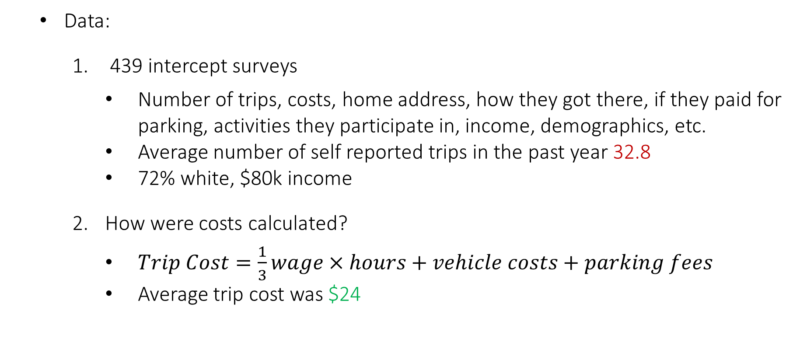
Valuing urban open space using the travel-cost method and the implications of measurement error (here)
By: Hanauer and Reid (2017)
Data:
439 intercept surveys
Number of trips, costs, home address, how they got there, if they paid for parking, activities they participate in, income, demographics, etc.
Average number of self reported trips in the past year 32.8
72% white, $80k income
How were costs calculated?
$Trip Cost=\frac{1}{3}wage×hours+vehicle costs+parking fees$
Average trip cost was $24

Slide 34
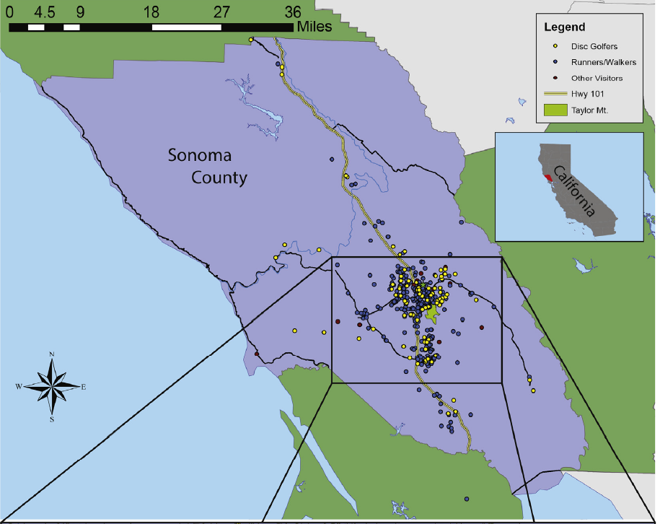
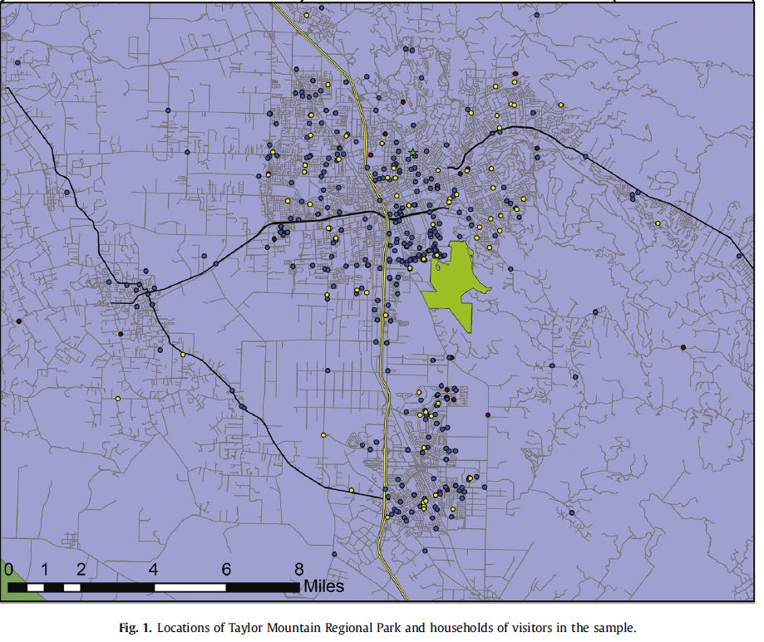

Slide 35
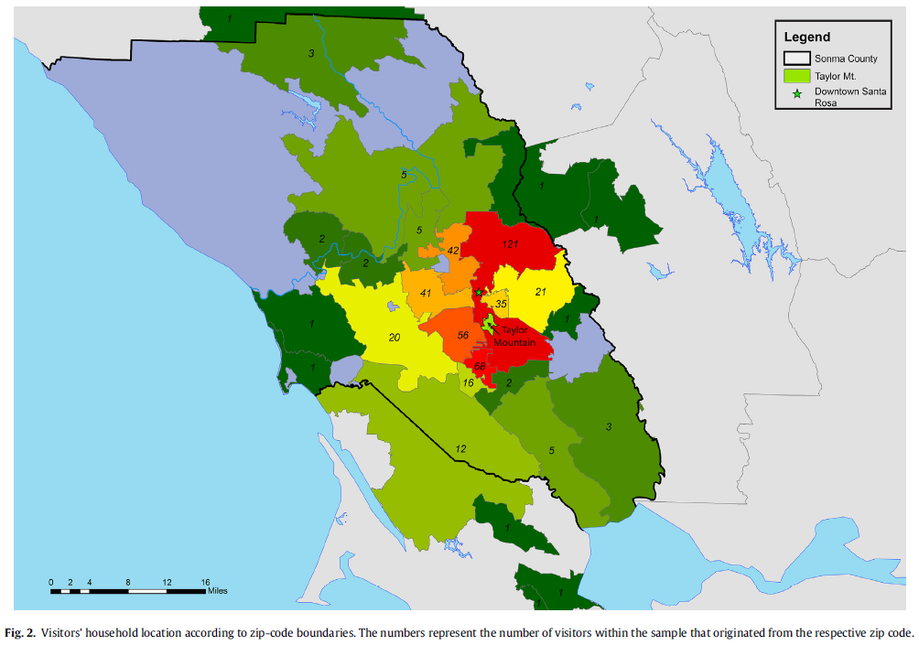

Slide 36
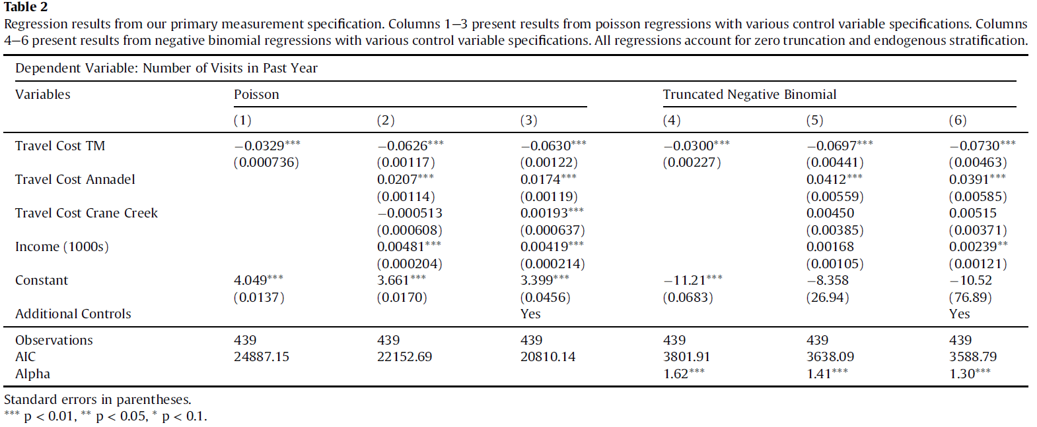
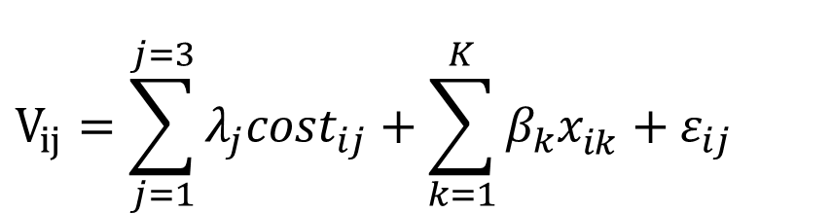
$$V_{ij}=\sum_{j=1}^{j=3}{λ_{j}cost_{ij}}+\sum_{k=1}^{K}{β_{k}x_{ik}^{}}+ε_{ij}$$

Slide 37
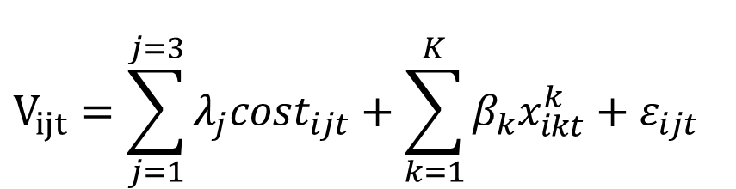
$$V_{ijt}=\sum_{j=1}^{j=3}{λ_{j}cost_{ijt}}+\sum_{k=1}^{K}{β_{k}x_{ikt}^{k}}+ε_{ijt}$$

Slide 38
$$V_{ijt}=\sum_{j=1}^{j=3}{λ_{j}cost_{ijt}}+\sum_{k=1}^{K}{β_{k}x_{ikt}^{k}}+ε_{ijt}$$

Slide 39
$$V_{ijt}=\sum_{j=1}^{j=3}{λ_{j}cost_{ijt}}+\sum_{k=1}^{K}{β_{k}x_{ikt}^{k}}+ε_{ijt}$$

Slide 40
$$V_{ijt}=\sum_{j=1}^{j=3}{λ_{j}cost_{ijt}}+\sum_{k=1}^{K}{β_{k}x_{ikt}^{k}}+ε_{ijt}$$

Slide 41
$$V_{ijt}=\sum_{j=1}^{j=3}{λ_{j}cost_{ijt}}+\sum_{k=1}^{K}{β_{k}x_{ikt}^{k}}+ε_{ijt}$$

Slide 42
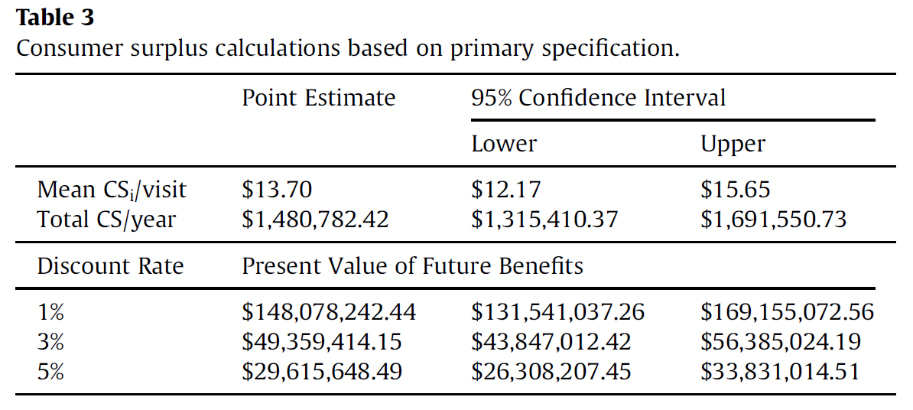

$$\overline{CS}= \frac{1}{λ}$$

Slide 43
$$\overline{CS}= \frac{1}{λ}$$

Slide 44
$$\overline{CS}= \frac{1}{λ}$$

Slide 45
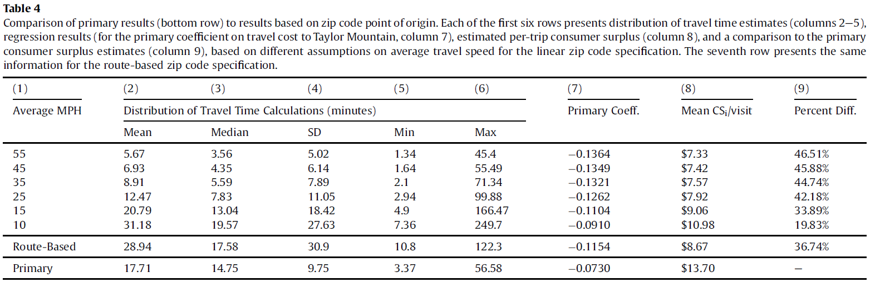
Does using zip-code level data to estimate travel costs bias the results?
The authors find that by failing to account for within-zip-code variation in travel costs the per trip consumer surplus and, thus, the overall benefits of Taylor Mountain Regional Park are underestimated compared to when more accurate individual-level costs are used.

Slide 46
Next class
Hedonics:
Two papers:
Muehlenbachs et al. (2015)
Christensen and Timmins (2023): (read the intro. For those interested in causal inference, also read Sec 3.)
Case Study #1 due Sept 17th by 11:59pm
Estimate a travel cost model.
Data and code are provided! You will run the script, get acquainted with the R environment, and provide some analysis of the results.
Your job will be to submit a writeup and code (using the provided R markdown template), explain the intuition, any potentially missing information/data that you would have like to have included in the analysis.

